Slide 1
PROJECT PRESENTATION
EduGenie
Google Gemini Powered Learning Assistant
Ask • Explain • Summarize • Quiz • Learning Path

Slide 2





One assistant, five learning tools
Helps learners ask questions, understand concepts, summarize material, test knowledge and follow structured learning paths.
Smart Q&A
Explain
Summarize
Quiz
Learning Path
Direct, clear answers
Beginner-friendly, 5 sections
Revision notes fast
3 MCQs with score
Basics to final project
EduGenie | Features

Slide 3
Technology stack
Frontend
Backend
AI
Config
HTML5
CSS3
JavaScript
Python
FastAPI
Uvicorn + Jinja2
Google Gemini API
google-genai SDK
Gemini 3.8 Flash
python-dotenv
Pydantic
Render hosting
EduGenie | Stack

Slide 4
How a request flows
Browser
FastAPI
Module
Gemini
Response
▶
▶
▶
▶
HTML / CSS / JS
main.py
qna, quiz ...
gemini_utils.py
JSON to browser
1
User picks a tool and enters text
2
JavaScript sends a POST to the endpoint
3
Pydantic validates the request
4
The module builds an educational prompt
5
Fallback logic calls Gemini, result returns as JSON
EduGenie | Architecture

Slide 5
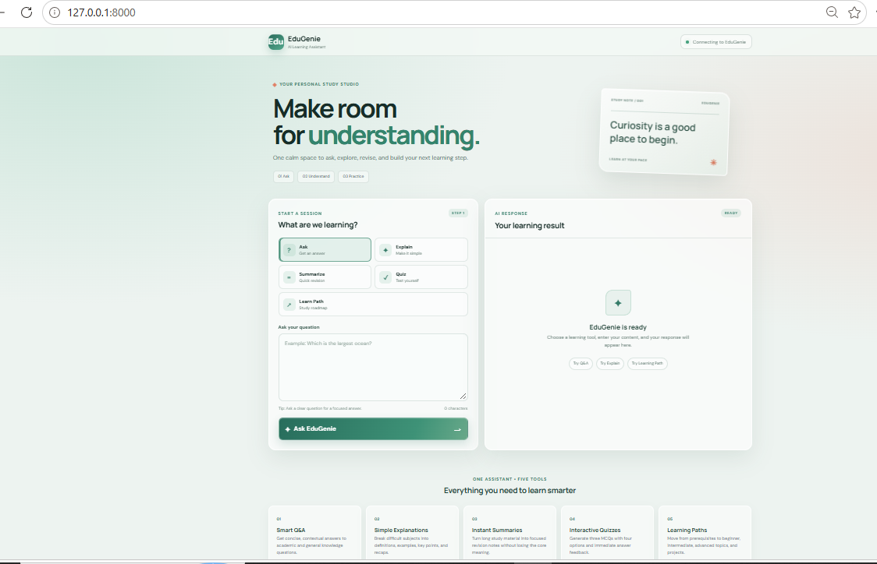
The web portal
Tool selector
Ask, Explain, Summarize, Quiz, Learn Path
Input card
Text area, tip and character counter
AI Response panel
Shows results and interactive quiz
EduGenie | Output

Slide 6
Modules and REST endpoints
Module | Endpoint | Purpose
qna.py | POST /qa | Educational Q&A
explanation_module.py | POST /explain | Beginner explanation
summary_module.py | POST /summarize | Revision summary
quiz_module.py | POST /quiz | 3 MCQs, structured JSON
learning_path.py | POST /learn/recommendations | Learning roadmap
main.py | GET /health | Service status
EduGenie | API

Slide 7
Automatic model fallback
gemini_utils.py keeps the app working if a model fails
DEFAULT_MODELS = [
"gemini-3.8-flash", "gemini-3.5-flash-lite",
"gemini-3.5-flash", "gemini-2.5-flash",
]
for model_name in get_model_candidates(preferred_model):
try:
return client.models.generate_content(
model=model_name, contents=prompt)
except Exception as exc:
if _should_try_next_model(exc): # 404, 429, 5xx
continue
raise
Retries on 404, 429, 500, 502, 503, 504 or 'not found' style errors.

Slide 8
Structured quiz output
quiz_module.py forces valid JSON with a Pydantic schema
class QuizQuestion(BaseModel):
question: str
options: List[str] = Field(min_length=4, max_length=4)
correct_answer: str
class QuizResponse(BaseModel):
questions: List[QuizQuestion] = Field(min_length=3, max_length=3)
response = generate_with_fallback(
client, prompt, model_name, response_schema=QuizResponse)
quiz = QuizResponse.model_validate_json(response.text)
return quiz.model_dump()
Exactly 3 questions and 4 options each, validated before reaching the browser.

Slide 9
Run it and deploy it
Run locally (Windows)
Deploy on Render
python -m venv venv
venv\Scripts\activate
pip install -r requirements.txt
copy .env.example .env
uvicorn main:app --reload
Push the project to GitHub
Create a Blueprint from render.yaml
Add GEMINI_API_KEY as a secret
Deploy and open the Render URL
Open http://127.0.0.1:8000 (docs at /docs)
Health check path: /health
EduGenie | Setup

Slide 10
What comes next
User accounts and history
Progress dashboard
PDF, image and voice input
Multilingual learning
Teacher and parent dashboard
Adaptive learning from quiz scores
Thank you
EduGenie: make room for understanding.

